Slide 1
Type 2 Diabetes in Manitoba

Slide 2
Research Objectives
Analyze the major trends in Type 2 Diabetes (T2DM) prevalence, incidence, complications and mortality
Describe the impact of T2DM across the life course
Look at use of health services, social services, and educational outcomes, as well as complications and co-morbidities
Describe the outcomes/indicators separately for T2DM in the First Nation population

Slide 3
Key Findings Overall
Population burden of type 2 diabetes is increasing
Faster in younger age groups
Control of type 2 diabetes is poor throughout the population
Both rates and complications of type 2 diabetes are higher in the First Nation population
Many people are not receiving care as recommended by Diabetes Canada

Slide 4
Incidence of Type 2 Diabetes
Crude incidence (2015/16 to 2016/17):
First Nation Manitobans was 7.6 per 1,000 person-years
All Other Manitobans was 5.7 per 1,000 person years
Age- and sex-adjusted incidence is almost 2x (RR 1.97, 1.51-2.56)
No differences between health regions when stratified by First Nation/All Other Manitobans

Slide 5
Details of New Visualizations
First of all, I changed all the visualizations and presented them in a much simpler way, as the existing graphs were very complex to understand.
I tried to make all visualizations self explanatory and easiy understandable.
To make new visuals, I imported all the data from Diabetes_Graphs_Data to Power BI. I cleaned all the data in power query and loaded to power view where I created new visuals.
I will explain how I cleaned data to make new visuals in upcoming slides I will add one slide after inserting new visuals with complete details and rationale.

Slide 6
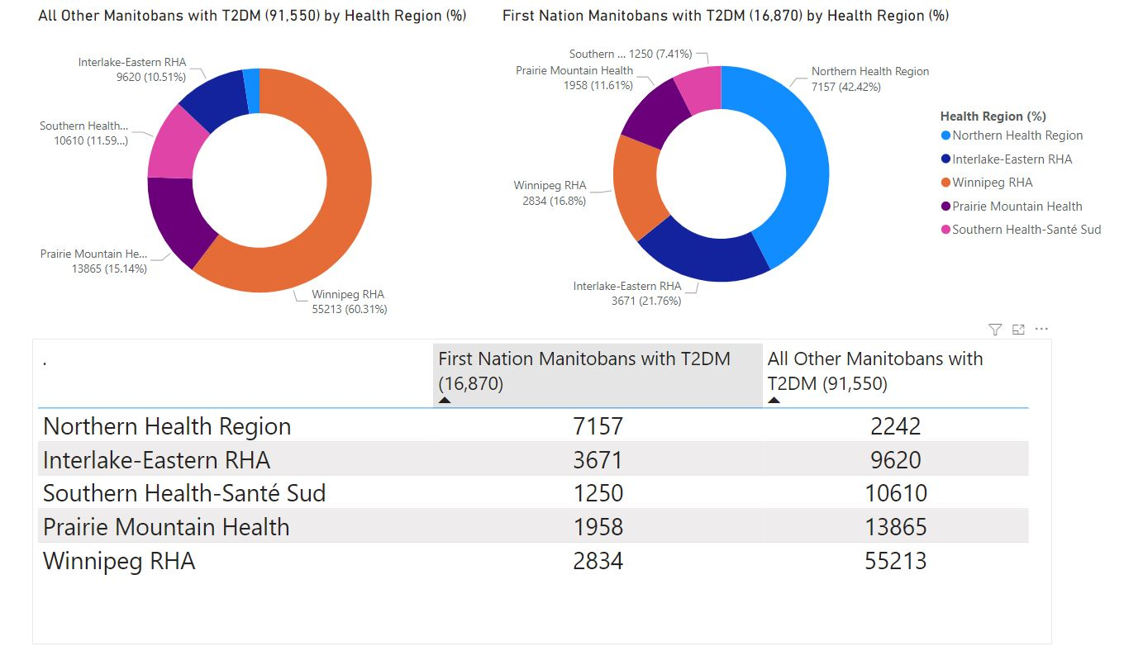
Figure 1. Health Region Distribution of First Nation Manitobans and all other Manitobans with Type 2 Diabetes, 2015/16-2016/17.

Slide 7
Rationale for making New Visualizations (Fig 1)
I changed existing graph to donut chart because it is reader friendly and it gives the distribution in % which makes it easier to extract information from visual.
From existing graph, it was hard to find and compare exact % in different regions because different colors (representing regions) were merging into each other.
This graph clearly show health region distribution of First Nation Manitobans and all other Manitobans with Type 2 diabetes.
Each portion of donut represent % of Manitobans ( Both first nation and others ) with T2DM indifferent regions.
For e.g. Orange colour on left side shows 60.31% of all other Manitobans in Winnipeg RHA which can easily be compared with orange part of donut chart on right which shows only 16.8% of First Nation Manitobans with T2DM in that region. Similar comparison goes with other regions.
Table below shows the number of all Manitobans and First Nation with T2DM in different regions.

Slide 8
Steps in Creating New Visualizations (Fig 1)
First of all I imported data from given excel file and worked on diabetes_ region_data to create this visual.
After importing data to Power BI, I cleaned the data and modified it.
I promoted headers, removed extra Column and rows.
Then I loaded data created Figure 1 in power report.

Slide 9
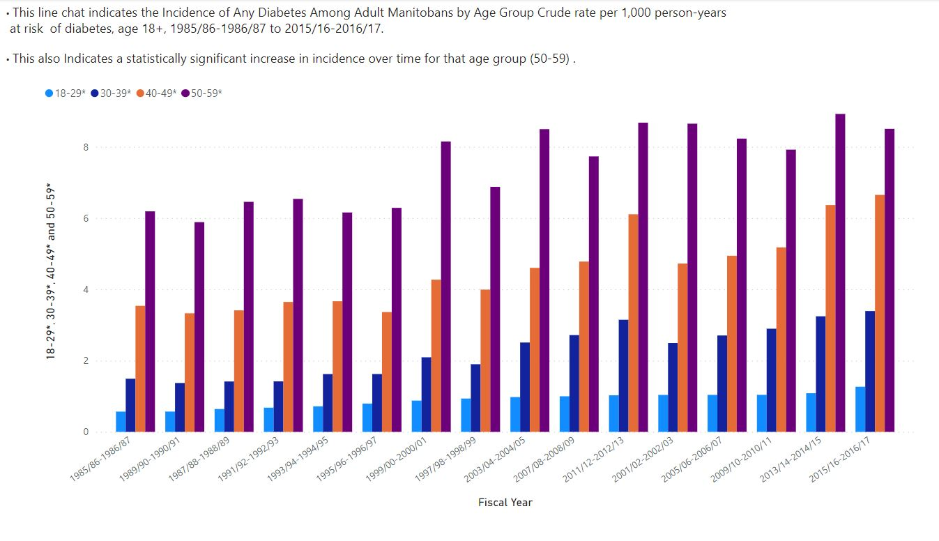
Figure 2 Time evolution of Diabetes for different age Groups.
Notes:
Say that older age groups were analyzed but not included as they were higher but followed similar trend

Slide 10
Rationale for making New Visualizations (Fig 2)
I used the clustered column chart to represent time evolution of diabetes in different age groups. This because we have four discrete age groups corresponding to each fiscal year. It shows the direct comparison in different age groups clearly.
In this chart, it is easier to differentiate the values in different age groups as well as variation of values in each age group over time by comparing column lengths.
The line chart in existing visual tend to lose clarity because there were 4 age categories corresponding to single point (i.e year). Moreover, plotting 4 lines over the graph makes it cluttered and confusing to read.
Furthermore, I removed the title “New diagnosis of diabetes are increasing in younger age group”. This seems not major finding of this graph as diabetes is increasing in all age groups.

Slide 11
Steps in Creating New Visualizations (Fig 2)
First of all I imported data from given excel file and worked on diabetes_ age_data to create this visual.
After importing data to Power BI, I cleaned the data and modified it.
I promoted headers.
Then I loaded data created Figure 2 in power report.

Slide 12
Type 2 diabetes is occurring at a younger age. Screening guidelines need to be updated.
Type 2 diabetes in adults is being diagnosed at younger ages over time
Mean age is decreasing
Paediatric population with type 2 diabetes is growing
Incidence in First Nations children is highest in the world
Increased from 110 to 154 per 100,000 over 9 years
Increasing rates of new type 2 diabetes in youth and young adults who are not registered First Nation
Incidence increasing: from 4.9 to 9 per 100,000
Notes:
Current screening guidelines for those ≥ 18 years of age recommend screening starting at age 40, or earlier in the presence of risk factors every 3 years (DC guidelines REF). In light of our findings this should be re-evaluated and the recommendation for “earlier screening” in the presence of risk factors be more clearly defined. We have also seen increased incidence of type 2 diabetes in women of child bearing age, reinforcing the need for early (first prenatal visit) screening in women at risk.

Slide 13
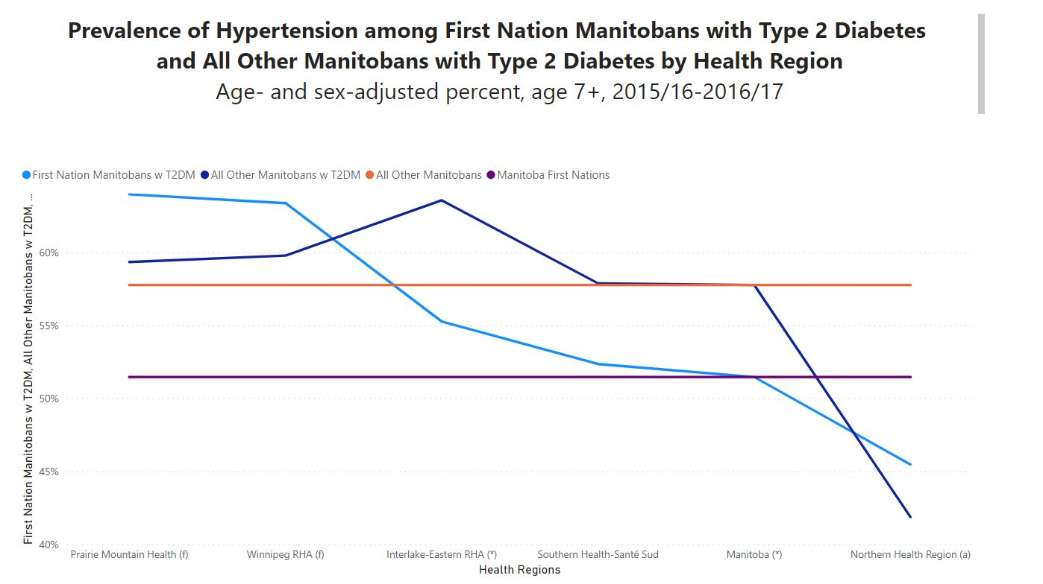
Fig 3. Variation of Hypertension among Manitobans in different regions

Slide 14
Rationale for making New Visualizations (Fig 3)
The existing graph combines bar chart with lines ,so it was hard to understand. Two legends were represented by bars and other two with lines which makes it confusing.
I replaced current visuals with line chart which is displaying information clearly.
The graph shows that % of First nations and all other Manitobans with hypertension remains constant over different regions.
The First Nations & others Manitobans with T2DM are more prone to hypertension in some regions like “prairie mountain health” & “interlake eastern RHA “ and are less prone to Hypertension in “Northern health region”.
Furthermore, I replaced title of graph by more appropriate one.
Used hypert_region_data to draw this visual in power BI.

Slide 15
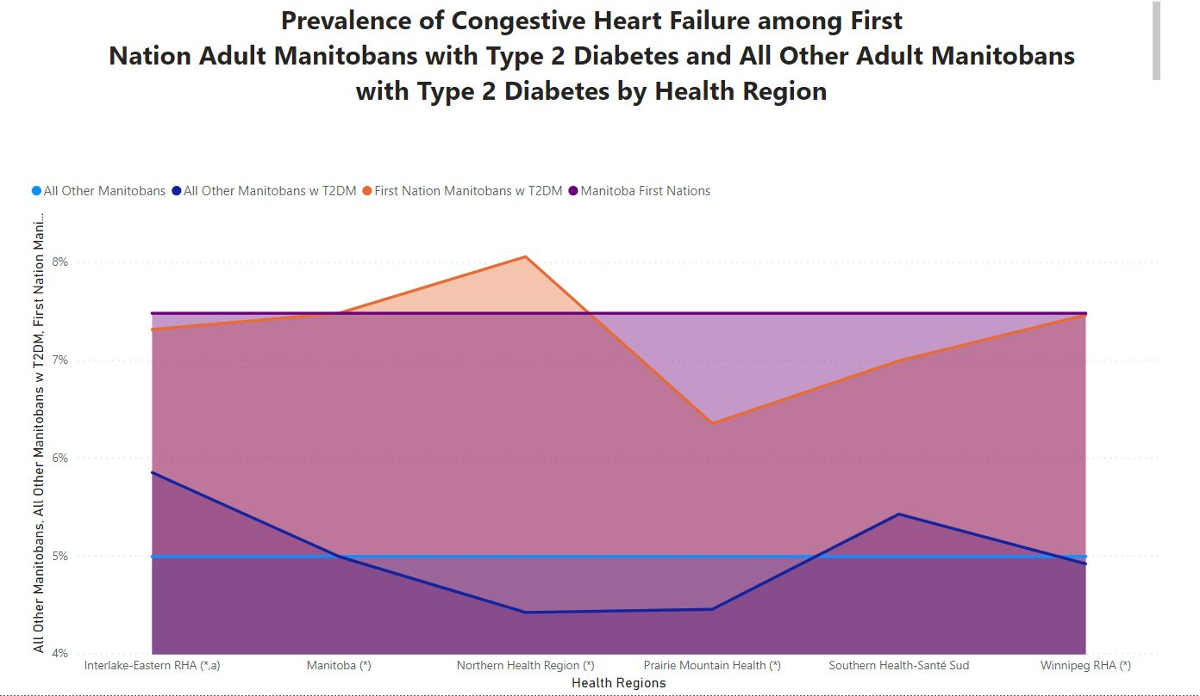

Fig 4. Variation of congestive heart failure among Manitobans in different regions

Slide 16
Rationale for making New Visualization (Fig 4)
The existing graph was very complex and all the information seems cluttered.
I replaced current visuals with area chart which is displaying information clearly.
The chart is same as line chart in Fig 3 except area below plotted line is filled with colour.
I used area chart to emphasize volume so that it can be easily grabbed by end users,
Furthermore, I replaced title of graph by more appropriate one.
Used CHF_region_data to draw this visual in power BI.

